Slide 1
Linear Algebra
Lecture 42

Slide 2
Linear Algebra
Lecture 42

Slide 3
Segment VI
Orthogonality and
Least Squares

Slide 4
Least Squares
Problems

Slide 5

Best Approximation
Theorem
Let W be a subspace of R^{n}, y any vector in R^{n}, and the orthogonal projection of y onto W.
…

Slide 6
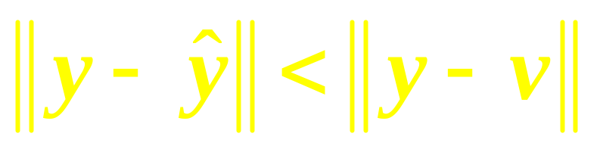
Continued
Then is the closest point in W to y, in the sense that
for all v in W distinct from .
…

Slide 7
Continued
The vector in this theorem is called the best approximation to y by elements of W.

Slide 8
Least-Squares
Problem
Inconsistent systems arise often in applications
…

Slide 9
Continued
When a solution of Ax = b is demanded and none exists, the best one can do is to find an x that makes Ax as close as possible to b.
…

Slide 10

Continued
Let us take Ax as an approximation to b. The smaller the distance between b and Ax, given by , the better the approximation.
…

Slide 11
Continued
The general least-squares problem is to find an x that makes
as small as possible.
…

Slide 12
Continued
The term least-squares arises from the fact that
is the square root of a sum of squares.

Slide 13

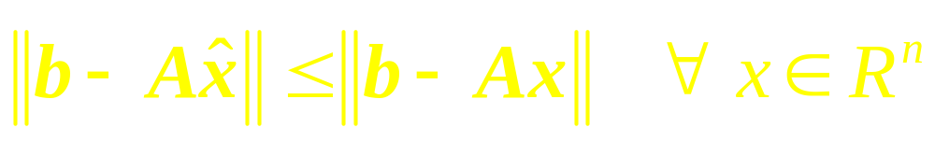
Definition
If A is m x n and b is in R^{m}, a least-squares solution of Ax = b is an in R^{n} such that

Slide 14
Solution of the General
Least-Squares Problem

Slide 15

Theorem
The set of least-squares solutions of Ax = b coincides with the nonempty set of solutions of the normal equations

Slide 16
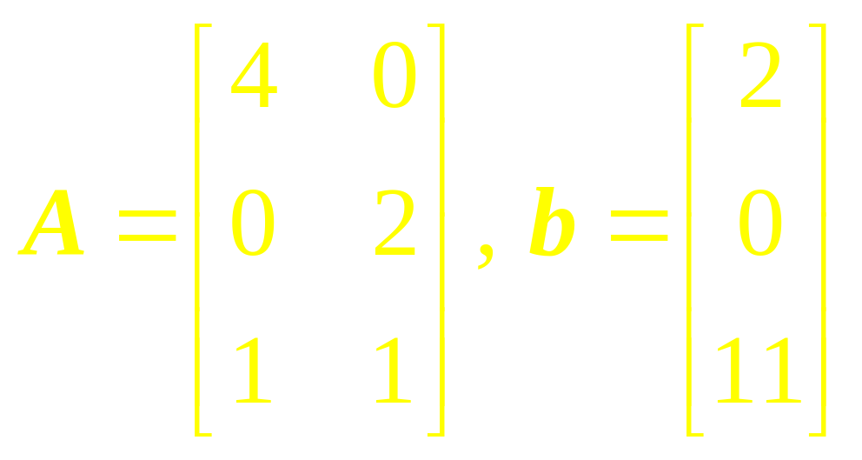
Example 1
Find a least-squares solution of the inconsistent system Ax = b for

Slide 17
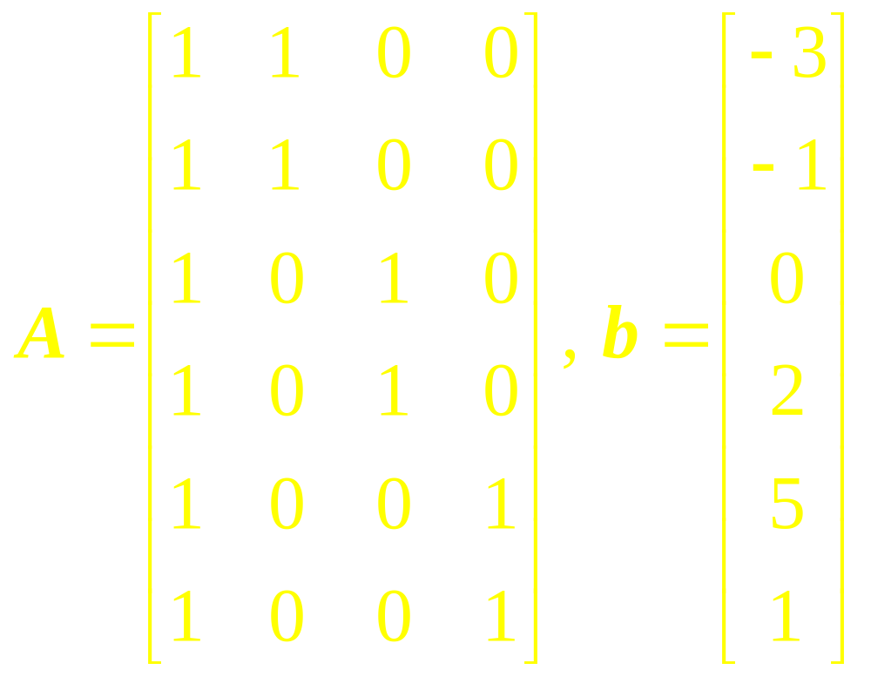
Example 2
Find a least-squares solution of Ax = b for

Slide 18

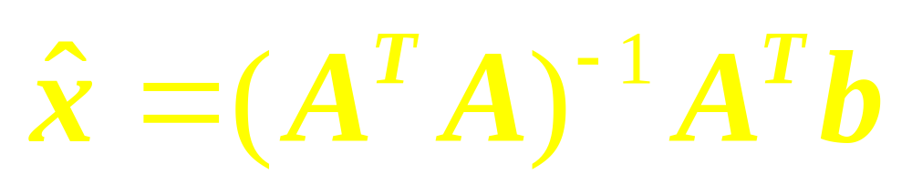
Theorem
The matrix A^{T}A is invertible iff the columns of A are linearly independent. In this case, the equation Ax = b has only one least-squares solution , and it is given by

Slide 19
Example 3
Determine the least-squares error in the least-squares solution of Ax = b.

Slide 20
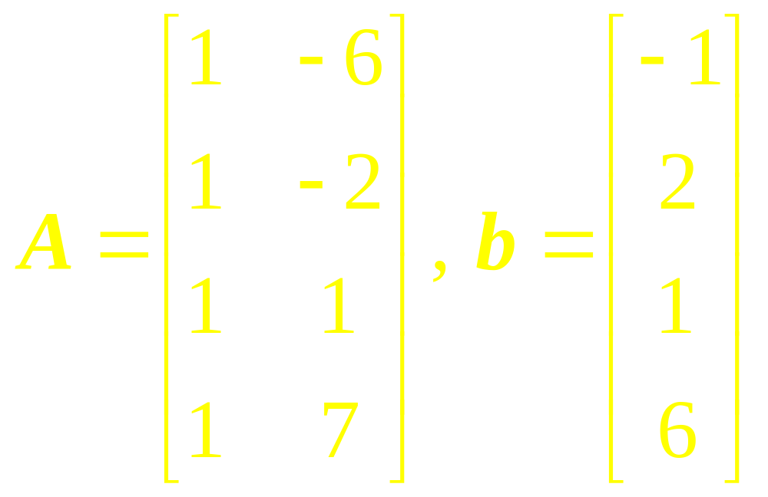
Example 4
Find a least-squares solution of Ax = b for

Slide 21
Theorem
Given an m x n matrix A with linearly independent columns, let A = QR be a QR factorization of A.
…

Slide 22
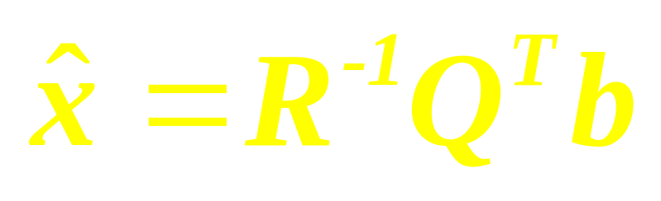
Continued
Then for each b in R^{m}, the equation Ax = b has a unique least-squares solution, given by

Slide 23
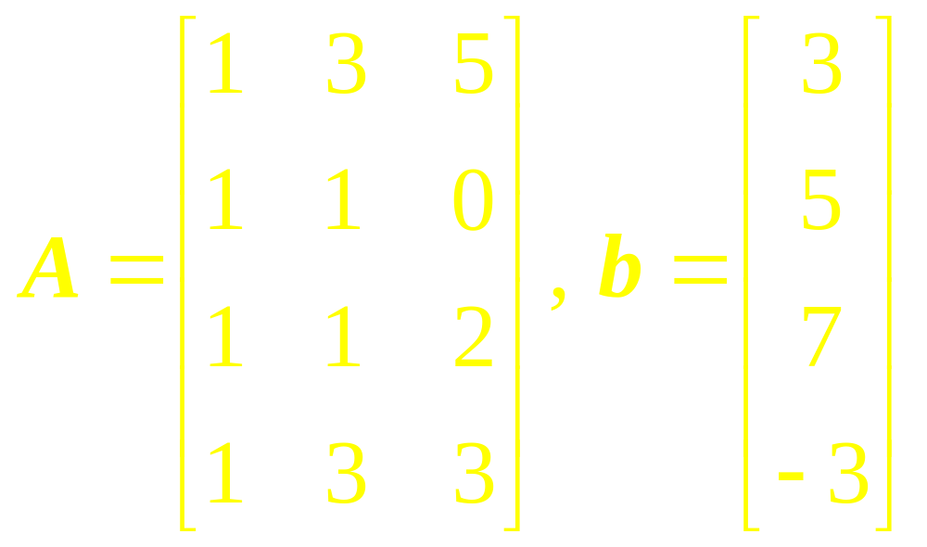
Example 5
Find the least-squares solution of Ax = b for

Slide 24
Linear Algebra
Lecture 42

